Slide 1


Business Requirements Tracker & Workflow
DIGITALIZATION
POC Proposal - Use Case #1
Presented By
Project Management Team
((O)) JLL
SEE A BRIGHTER WAY

Slide 2

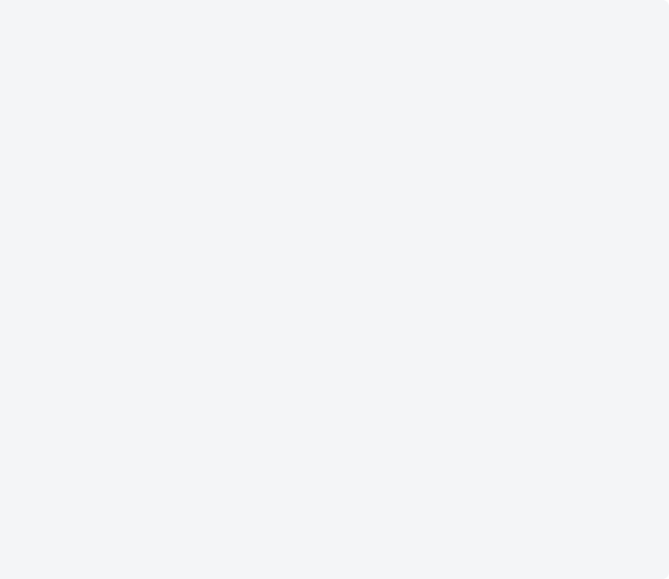
Overview
01
In Scope
•
Automated routing of requirement documents.
•
Real-time status tracking dashboards for stakeholders.
Business Problem:
•
Standardized digital intake forms.
Manual tracking of business requirements leads to severe delays, cross-departmental miscommunication, and a complete lack of real-time visibility into project statuses, resulting in scattered data and operational inefficiency.
•
Basic email notifications and alerts based on phases.
02
Out of Scope
•
Legacy system historical data migration.
•
Complex integrations with existing ERP systems.
Project Objective:
•
Custom mobile application development.
•
Digitize and automate the requirement tracking workflow to establish a single source of truth.
•
Vendor external portal access.
•
Enhance cross-functional collaboration and real-time reporting.
03
Assumptions
•
All required stakeholders will provide timely approvals.
•
Automate workflows based on business operations with systematic tracking.
•
Existing IT infrastructure can support the new SaaS tool.
•
Significantly reduce overall cycle times across departments.
•
Subject Matter Experts (SMEs) will be available for UAT.
04
Risks
Target Users:
•
Resistance from teams accustomed to legacy manual processes.
•
Sales SPOCs
•
Potential scope creep during the feedback phase.
•
Procurement SPOCs
•
Unforeseen delays in securing necessary IT security sign-offs.
•
Finance SPOCs
•
Executive Sponsors

Slide 3

High Level Process Map
⚡ TRIGGER EVENT: [Client Email/RFP Received] OR [Lease Expiry Alert]
1. SALES STAGE
2. PROCUREMENT STAGE
3. FINANCE STAGE
SALES SPOC
Upload Email / Document
AI Extraction & Auto-Populate
Review & Complete Requirements
Submit for Approval
PROCUREMENT SPOC
Add Vendor Details & Verification
Associate Client & BU Details
Input & Validate Contract Value
Submit for Compliance Check
FINANCE SPOC
Add Invoice Details & Validation
Input PO Details & Payment
Verify Budget & Terms
Submit for Final Sign-off
arrow_forward
arrow_forward
SALES HEAD (APPROVER)
Review Requirements & Decision
✔ Approve ➔ Lock Requirements
✘ Reject ➔ Return to Sales SPOC
PROCUREMENT HEAD (APPROVER)
Review Details & Compliance Sign-off
✔ Approve ➔ Lock System
✘ Reject ➔ Return to Proc.
FINANCE HEAD
✔ Approve ➔ Lock & Version
✘ Reject ➔ Return
END STATE
Requirements Fully Approved & Locked
🔄 ONGOING MONITORING & VARIATIONS (WES Operations & All SPOCs)
Real-Time Dashboard & Status Tracking via Power BI ➔ Change Detection ➔ Trigger Variation Workflow ➔ Automated Re-Approval Routing & Audit Trail Maintenance
End State: Requirements Fully Approved, Locked, & Ready for Execution

Slide 4
Project Details
SALES SPOC
PROCUREMENT SPOC
FINANCE SPOC
TRIGGER: Business Request
• Expiring Lease • Client Details • Email / RFP Upload
TRIGGER: Vendor Requirements
• Invoice & BU Details • Vendor Details • Contract Value
TRIGGER: Financial Parameters
• PO Details & Payment Status • Contract Details & Terms • Budget Verification Info
CAPTURE (AI)
• AI Extraction & Processing • Auto-Populate Requirement Form
CAPTURE (AI)
• Procurement SPOC Data Validation • Supplier Integrity Verification
CAPTURE (AI)
• Finance SPOC Review • Automated Data Validation & Auditing
GATHER & APPROVAL
• CRM Collects Data & Standard Templates • Sales SPOC Review & Updates • Sales Head Review & Approval
GATHER & APPROVAL
• Procurement SPOC System Review • Compliance Check • Procurement Head Approval
GATHER & APPROVAL
• Final Cost Validation • Finance Head Review & Sign-off • Budget Allocations Confirmed
LOCK & TRACK
Status: Approved
• Requirements Locked & Secured
LOCK & TRACK
Status: Approved
• System Requirements Locked
LOCK & TRACK
Status: Approved
• Requirements Locked & Version Control
WES Operations Team / SPOCs — Real-Time Monitoring & Dashboards
VARIATIONS MANAGEMENT: Business changes tracked & logged ➔ Complete audit trail maintenance ➔ Automated re-approval routing

Slide 5

Business Requirements Workflow
⚡ TRIGGER EVENT: [Client Email/RFP Received] OR [Lease Expiry Alert]
1. SALES STAGE
2. PROCUREMENT STAGE
3. FINANCE STAGE
SALES SPOC
• Upload Email / Document
• AI Extraction & Auto-Populate
• Review & Complete Requirements
• Submit for Approval
SALES HEAD (APPROVER)
• Review Requirements & Decision
✔ Approve ➔ Lock Requirements
✘ Reject ➔ Return to Sales SPOC
PROCUREMENT SPOC
• Add Vendor Details & Verification
• Associate Client & BU Details
• Input & Validate Contract Value
• Submit for Compliance Check
PROCUREMENT HEAD (APPROVER)
• Review Details & Compliance Sign-off
✔ Approve ➔ Lock System Requirements
✘ Reject ➔ Return to Procurement
FINANCE SPOC
• Add Invoice Details & Validation
• Input PO Details & Payment Status
• Verify Budget Parameters & Terms
• Submit for Final Sign-off
FINANCE HEAD (APPROVER)
• Review Financials & Budget Allocations
✔ Approve ➔ Lock & Version Control
✘ Reject ➔ Return to Finance SPOC
🔄 ONGOING MONITORING & VARIATIONS (WES Operations & All SPOCs)
Real-Time Dashboard & Status Tracking via Power BI ➔ Change Detection ➔ Trigger Variation Workflow ➔ Automated Re-Approval Routing & Audit Trail Maintenance
End State: Requirements Fully Approved, Locked, & Ready for Execution

Slide 6

Business Requirements Workflow
⚡ TRIGGER EVENT: [Client Email/RFP Received] OR [Lease Expiry Alert]
1. SALES STAGE
2. PROCUREMENT STAGE
3. FINANCE STAGE
SALES SPOC
Upload Email / Document
AI Extraction & Auto-Populate
Review & Complete Requirements
Submit for Approval
PROCUREMENT SPOC
Add Vendor Details & Verification
Associate Client & BU Details
Input & Validate Contract Value
Submit for Compliance Check
FINANCE SPOC
Add Invoice Details & Validation
Input PO Details & Payment
Verify Budget & Terms
Submit for Final Sign-off
arrow_forward
arrow_forward
SALES HEAD (APPROVER)
Review Requirements & Decision
✔ Approve ➔ Lock Requirements
✘ Reject ➔ Return to Sales SPOC
PROCUREMENT HEAD (APPROVER)
Review Details & Compliance Sign-off
✔ Approve ➔ Lock System
✘ Reject ➔ Return to Proc.
FINANCE HEAD
✔ Approve ➔ Lock & Version
✘ Reject ➔ Return
END STATE
Requirements Fully Approved & Locked
🔄 ONGOING MONITORING & VARIATIONS (WES Operations & All SPOCs)
Real-Time Dashboard & Status Tracking via Power BI ➔ Change Detection ➔ Trigger Variation Workflow ➔ Automated Re-Approval Routing & Audit Trail Maintenance
End State: Requirements Fully Approved, Locked, & Ready for Execution

Slide 7
High Level Process Map
⚡ TRIGGER EVENT: [Client Email/RFP Received] OR [Lease Expiry Alert]
1. SALES STAGE
2. PROCUREMENT STAGE
3. FINANCE STAGE
SALES SPOC
• Upload Email / Document
• AI Extraction & Auto-Populate
• Review & Complete Requirements
• Submit for Approval
SALES HEAD (APPROVER)
• Review Requirements & Decision
✔ Approve ➔ Lock Requirements
✘ Reject ➔ Return to Sales SPOC
PROCUREMENT SPOC
• Add Vendor Details & Verification
• Associate Client & BU Details
• Input & Validate Contract Value
• Submit for Compliance Check
PROCUREMENT HEAD (APPROVER)
• Review Details & Compliance Sign-off
✔ Approve ➔ Lock System Requirements
✘ Reject ➔ Return to Procurement
FINANCE SPOC
• Add Invoice Details & Validation
• Input PO Details & Payment Status
• Verify Budget Parameters & Terms
• Submit for Final Sign-off
FINANCE HEAD (APPROVER)
• Review Financials & Budget Allocations
✔ Approve ➔ Lock & Version Control
✘ Reject ➔ Return to Finance SPOC
arrow_forward
arrow_forward
🔄 ONGOING MONITORING & VARIATIONS (WES Operations & All SPOCs)
Real-Time Dashboard & Status Tracking via Power BI ➔ Change Detection ➔ Trigger Variation Workflow ➔ Automated Re-Approval Routing & Audit Trail Maintenance
End State: Requirements Fully Approved, Locked, & Ready for Execution

Slide 8
Business Requirements Workflow
⚡ TRIGGER EVENT: [Client Email/RFP Received] OR [Lease Expiry Alert]
1. SALES STAGE
SALES SPOC
Upload Email / Document
AI Extraction & Auto-Populate
Review & Complete Requirements
Submit for Approval
SALES HEAD (APPROVER)
Review Requirements & Decision
✔ Approve ➔ Lock Requirements
✘ Reject ➔ Return to Sales SPOC
3. FINANCE STAGE
FINANCE SPOC
Add Invoice Details & Validation
Input PO Details & Payment
Verify Budget & Terms
Submit for Final Sign-off
FINANCE HEAD
✔ Approve ➔ Lock & Version
✘ Reject ➔ Return
arrow_forward
arrow_forward
arrow_forward
PROCUREMENT SPOC
Add Vendor Details & Verification
Associate Client & BU Details
Input & Validate Contract Value
Submit for Compliance Check
PROCUREMENT HEAD (APPROVER)
Review Details & Compliance Sign-off
✔ Approve ➔ Lock System
✘ Reject ➔ Return to Proc.
FINANCE HEAD (APPROVER)
Review Financials & Budget Allocations
✔ Approve ➔ Lock & Version Control
✘ Reject ➔ Return to Finance SPOC
END STATE
Requirements Fully Approved & Locked
arrow_forward
arrow_forward
🔄 ONGOING MONITORING & VARIATIONS (WES Operations & All SPOCs)
Real-Time Dashboard & Status Tracking via Power BI ➔ Change Detection ➔ Trigger Variation Workflow ➔ Automated Re-Approval Routing & Audit Trail Maintenance
End State: Requirements Fully Approved, Locked, & Ready for Execution

Slide 9
Business Requirements Workflow
⚡ TRIGGER EVENT: [Client Email/RFP Received] OR [Lease Expiry Alert]
1. SALES STAGE
2. PROCUREMENT STAGE
3. FINANCE STAGE
SALES SPOC
• Upload Email / Document
• AI Extraction & Auto-Populate
• Review & Complete Requirements
• Submit for Approval
SALES HEAD (APPROVER)
• Review Requirements & Decision
✔ Approve ➔ Lock Requirements
✘ Reject ➔ Return to Sales SPOC
PROCUREMENT SPOC
• Add Vendor Details & Verification
• Associate Client & BU Details
• Input & Validate Contract Value
• Submit for Compliance Check
PROCUREMENT HEAD (APPROVER)
• Review Details & Compliance Sign-off
✔ Approve ➔ Lock System Requirements
✘ Reject ➔ Return to Procurement
FINANCE SPOC
• Add Invoice Details & Validation
• Input PO Details & Payment Status
• Verify Budget Parameters & Terms
• Submit for Final Sign-off
FINANCE HEAD (APPROVER)
• Review Financials & Budget Allocations
✔ Approve ➔ Lock & Version Control
✘ Reject ➔ Return to Finance SPOC
arrow_forward
arrow_forward
🔄 ONGOING MONITORING & VARIATIONS (WES Operations & All SPOCs)
Real-Time Dashboard & Status Tracking via Power BI ➔ Change Detection ➔ Trigger Variation Workflow ➔ Automated Re-Approval Routing & Audit Trail Maintenance
End State: Requirements Fully Approved, Locked, & Ready for Execution

